Slide 1

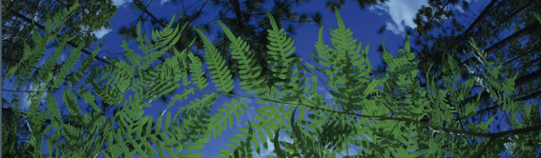
Georeferencing
University of Florida

Slide 2
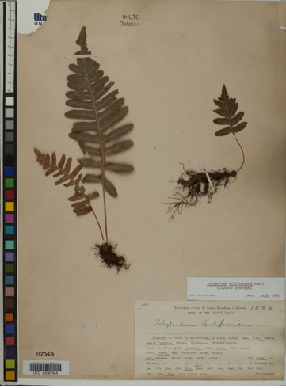
What is a georeference?

Slide 3
What is a georeference?
Species: Polypodium californicum
State: CA
County: Marin
Locality: Marin Municipal Water District Lands: Mount Tamalpais. Middle Peak Rd. culvert RT-3

Slide 4
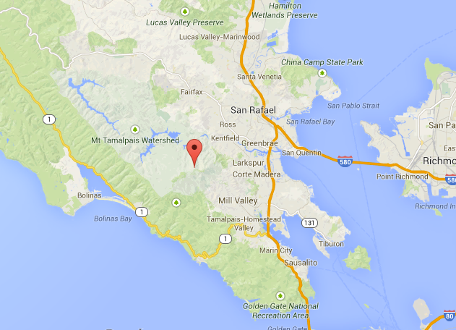
What is a georeference?

Slide 5
What is a georeference?
A numerical description of a
place that can be mapped

Slide 6
What is a georeference?
37.93, -122.59
A numerical description of a
place that can be mapped

Slide 7
Why georeference?
Correct geographic and specimen identification data = dependable occurrence record
Occurrence data validates the importance of biological collections, especially to non-taxonomists
Distribution of populations and species ranges
Phylogeography
Conservation planning and biodiversity management
Niche modeling
Provides uncertainty data, which allows data to be evaluated with regards to its fitness for research applications and the resulting quality of output

Slide 8
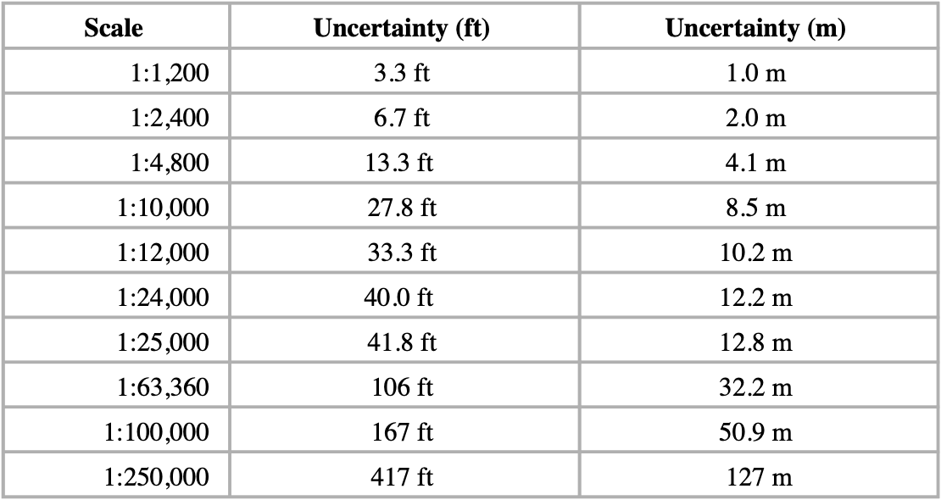
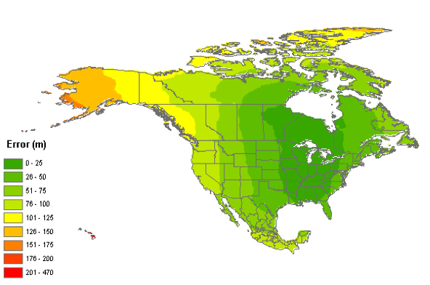
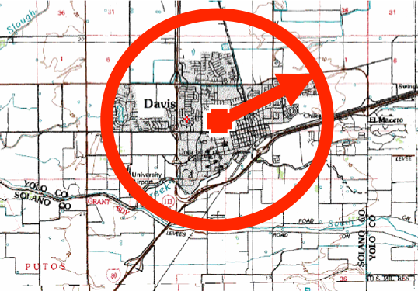
Sources of uncertainty
Coordinate uncertainty
Map scale
GPS accuracy
Unknown datum
Imprecision in direction measurements
Imprecision in distance measurements
Extent of locality
20° 30’ N 112° 36’ W

Slide 9
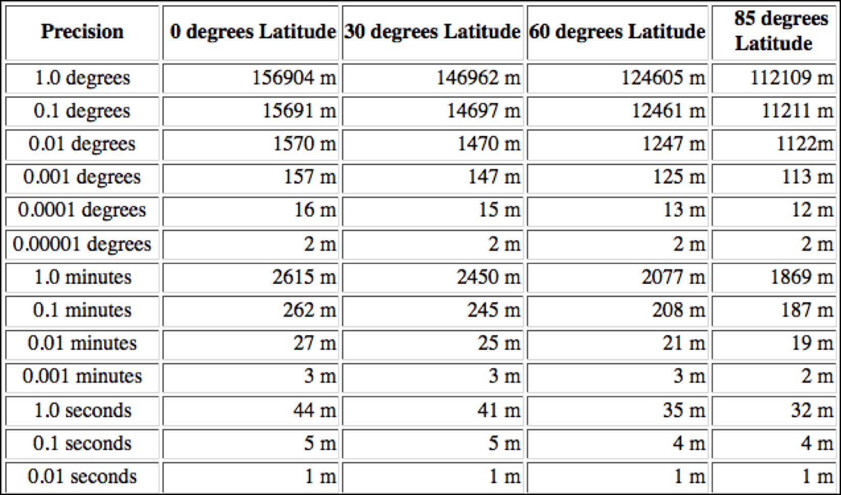
Coordinate uncertainty

Slide 10
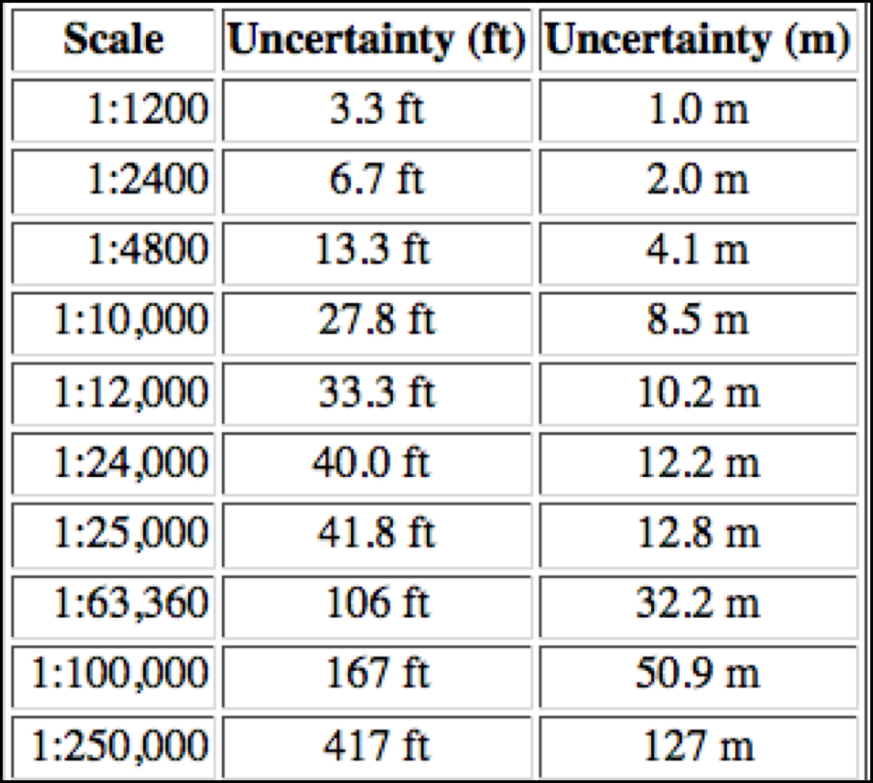
Map scale uncertainty
USGS Standard Map Accuracy

Slide 11
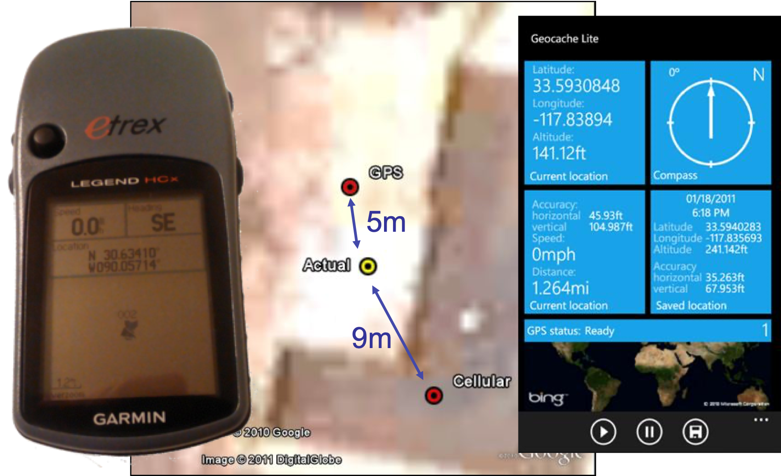
GPS uncertainty

Slide 12
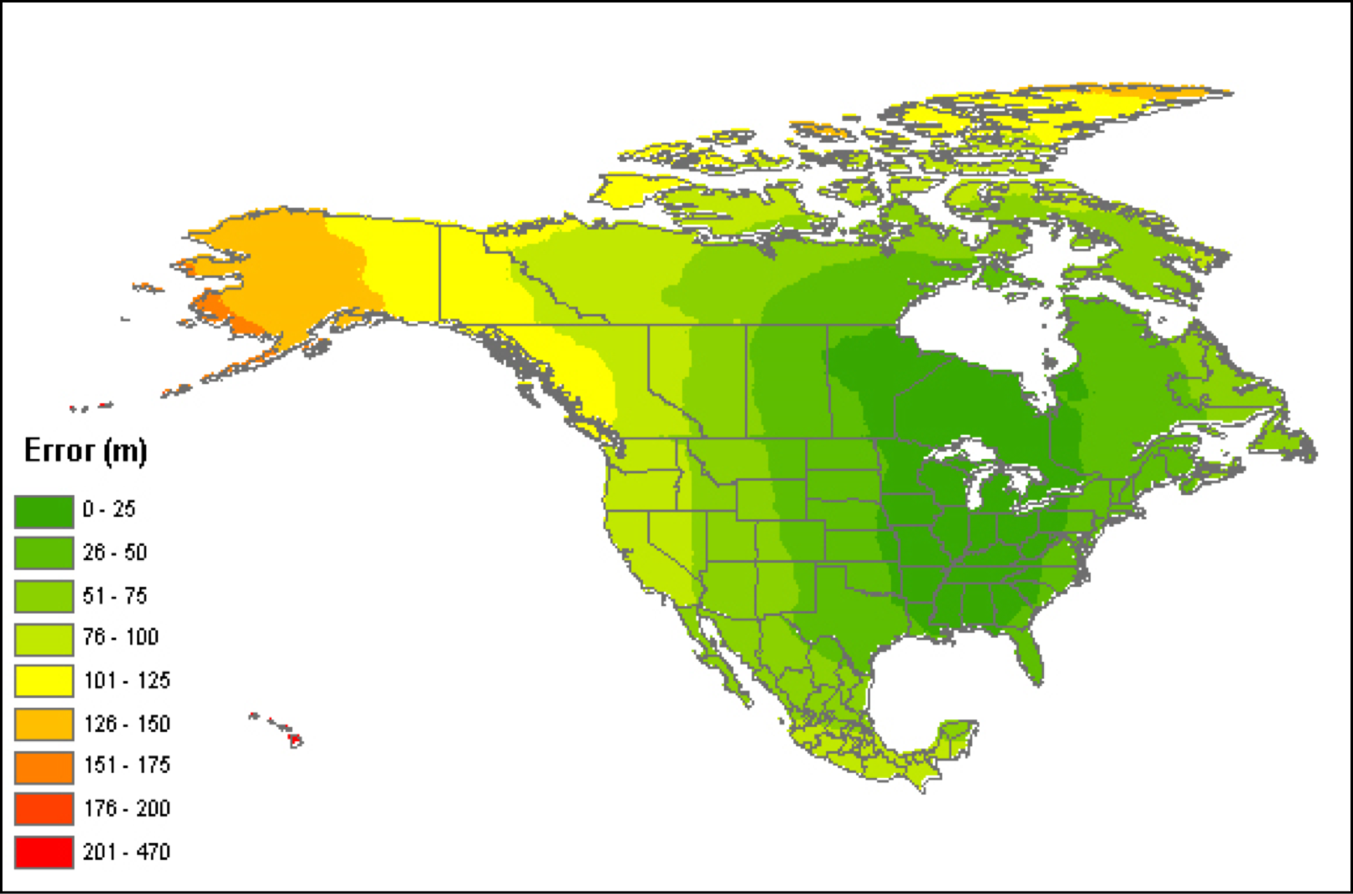
Datum uncertainty
Error assuming NAD27 vs NAD83 or WGS84

Slide 13
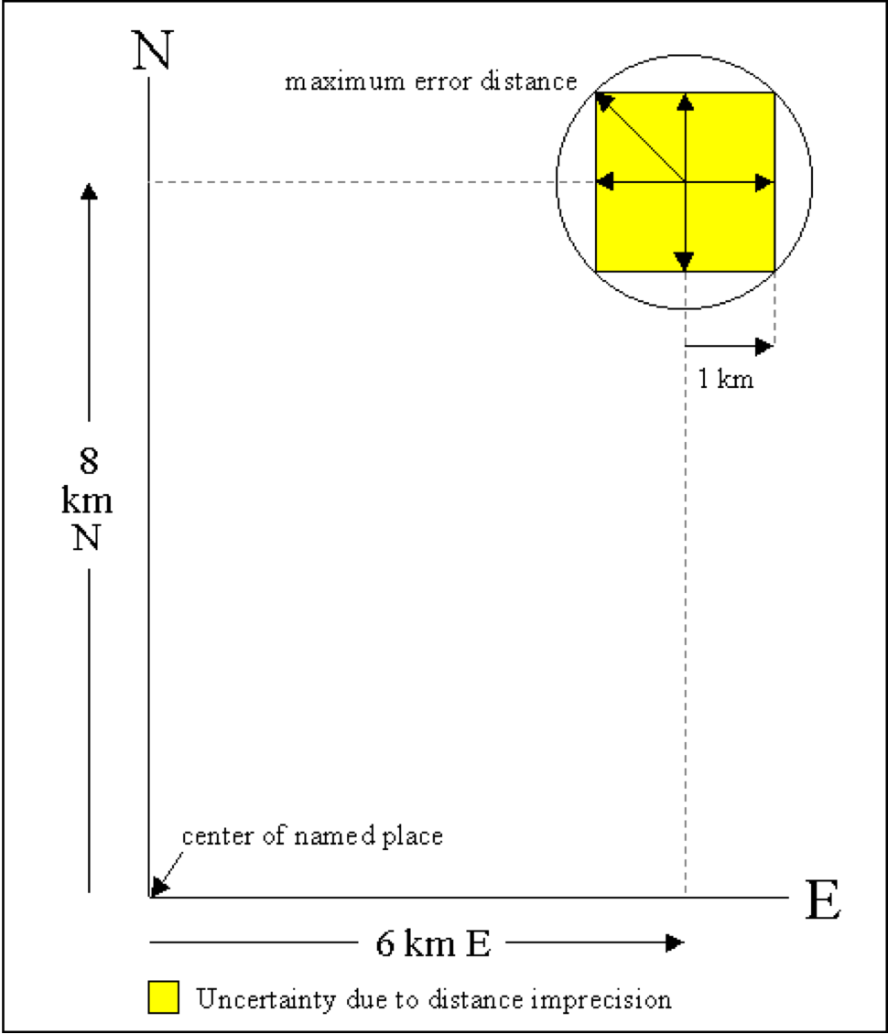
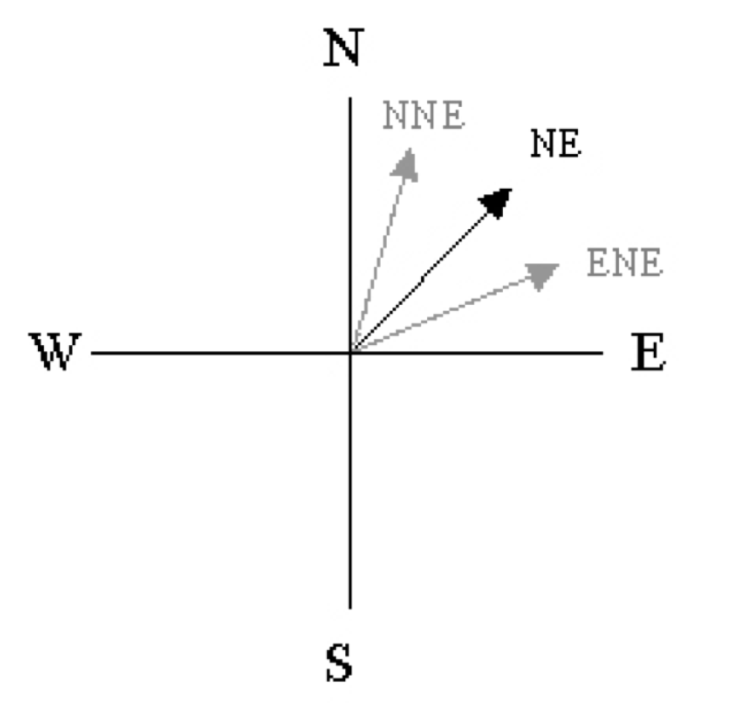
Direction and Distance measurement uncertainty
N > NE > ENE

Slide 14
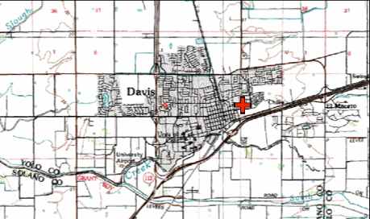
Extent of locality uncertainty
“Davis, Yolo County, CA”
Point Method
38.5463, -121.7425

Slide 15
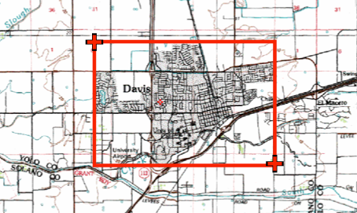
Extent of locality uncertainty
“Davis, Yolo County, CA”
Bounding-Box Method
38.5486, -121.7542
38.545, -121.7394

Slide 16
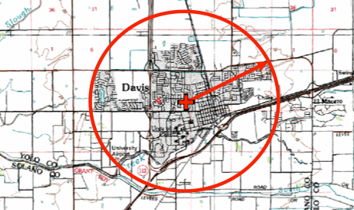
Extent of locality uncertainty
“Davis, Yolo County, CA”
Point-Radius Method
38.5468, -121.7469
Uncertainty radius: 8325 meters

Slide 17
Extent of locality uncertainty
“Davis, Yolo County, CA”
Note the uncertainty! If greater than the size of your variable layers, throw the locality away!
Point-Radius Method
38.5468, -121.7469
Uncertainty radius: 8325 meters

Slide 18
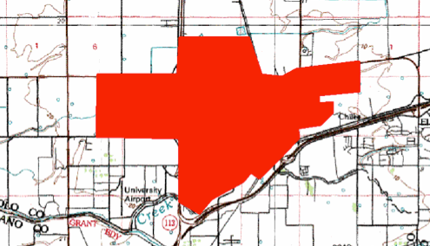
Extent of locality uncertainty
“Davis, Yolo County, CA”
Shape Method

Slide 19
What is an ideal georeference?

Slide 20
What is an ideal georeference?
A numerical description of a
place that can be mapped

Slide 21
What is an ideal georeference?
A numerical description of a
place that can be mapped
and that describes the spatial
extent of a locality and its associated uncertainties

Slide 22
What is an ideal georeference?
A numerical description of a
place that can be mapped
and that describes the spatial
extent of a locality and its associated uncertainties
as well as possible

Slide 23
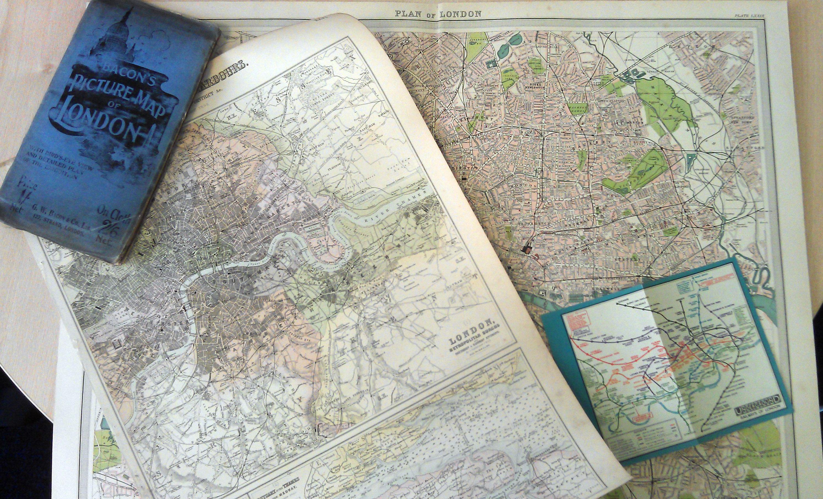
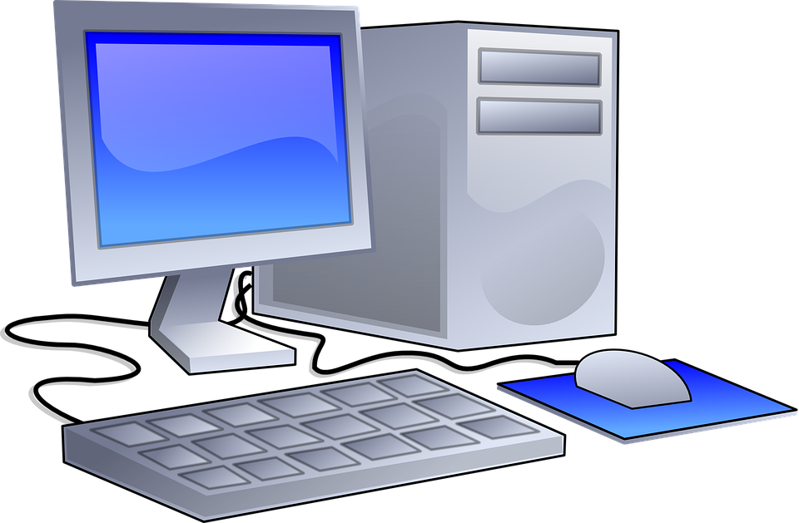
How to do it?
Paper Maps
Time-consuming
Good quality paper
maps may be hard
to find
Internet Resources

Slide 24

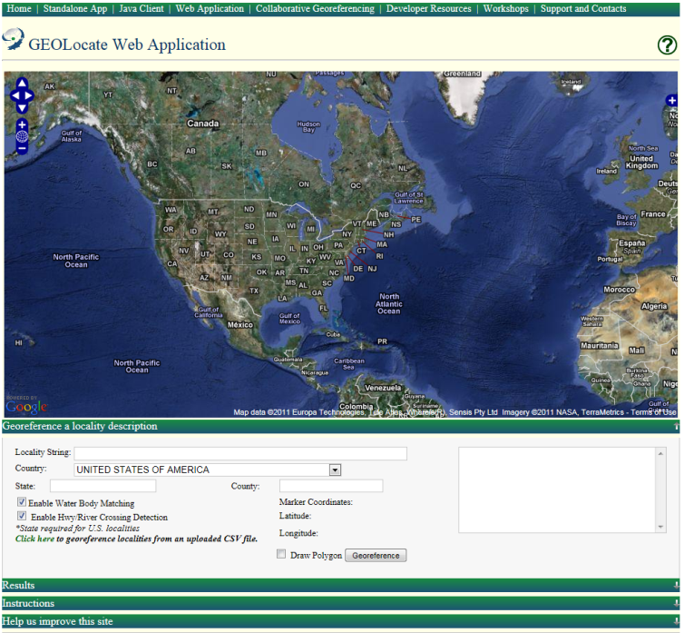
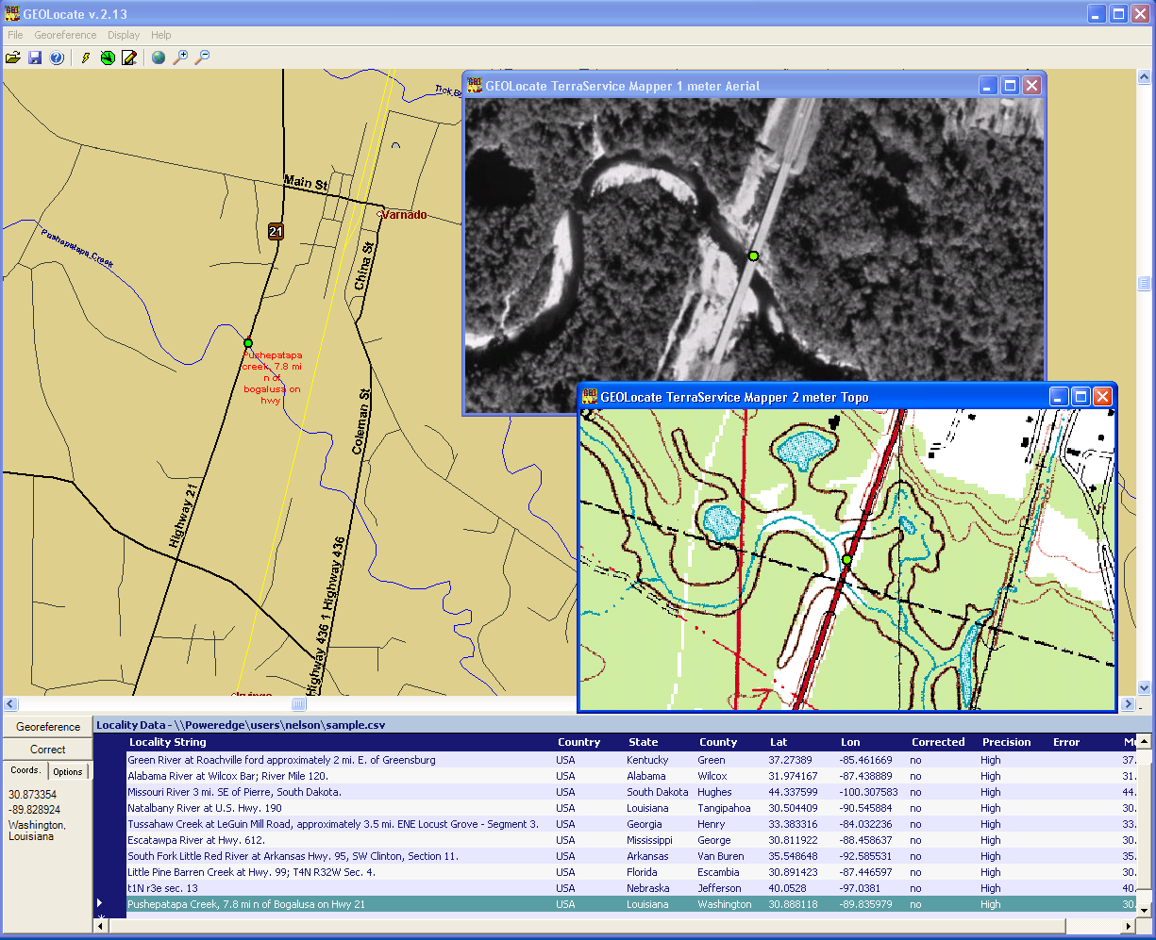
https://www.geo-locate.org/
Software services for georeferencing of natural history collection data
Automated georeferencing
Verification and correction
Multi-lingual
Interoperability
Training
Uncertainty determination
Batch processing
Collaborative georeferencing
Geographic visualization
Kml export

Slide 25
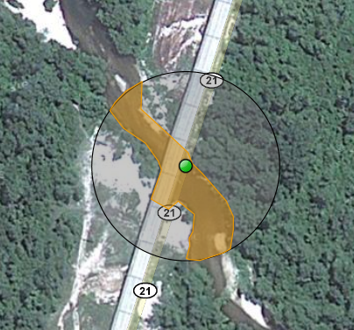
GeoLocate Workflow
pushepatapa creek, trib. to pearl river, 7.8 miles north of bogalusa at hwy 21; Washington; LA; USA
Data Entry & Preparation
1
Automated Processing
Georeferencing Algorithm
2
Visualize, verify & adjust output coordinates & uncertainties
Manual
Verification
3
latitude: 30.88797 longitude: -89.83601 uncertainty radius: 48m uncertainty polygon: 30.88823,-89.83641, 30.88815,-89.83634, 30.88808,-89.83622…

Slide 26
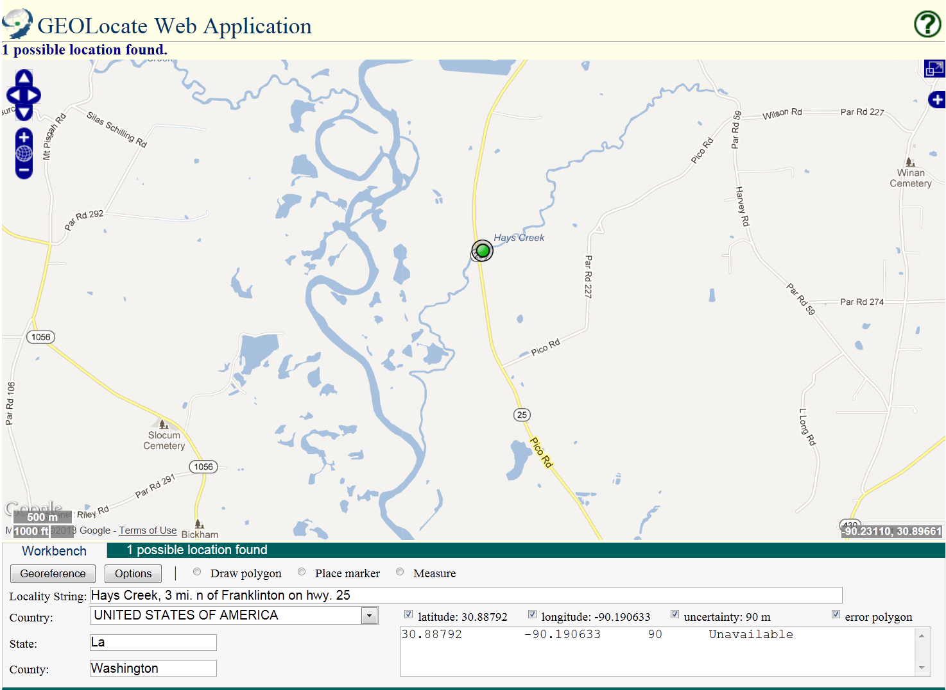
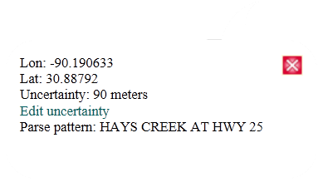
Core Features

Slide 27
Core Features

Slide 28
Core Features

Slide 29
Core Features

Slide 30
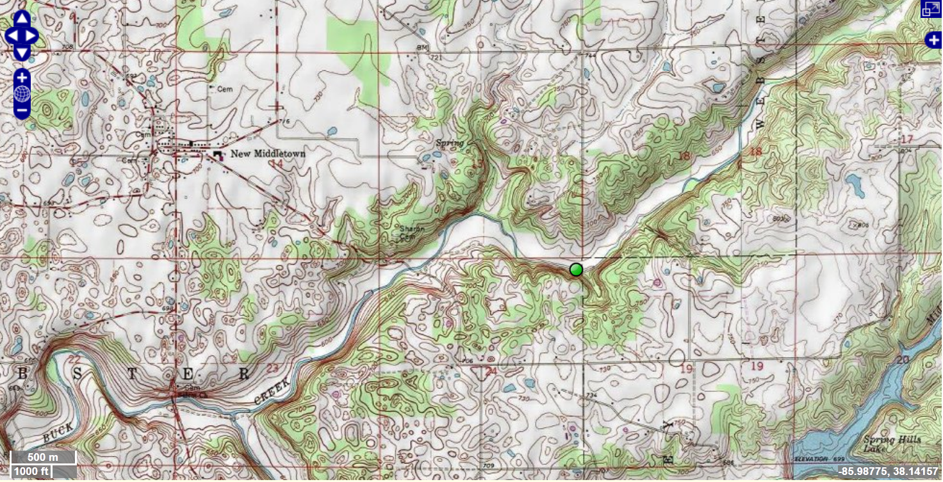
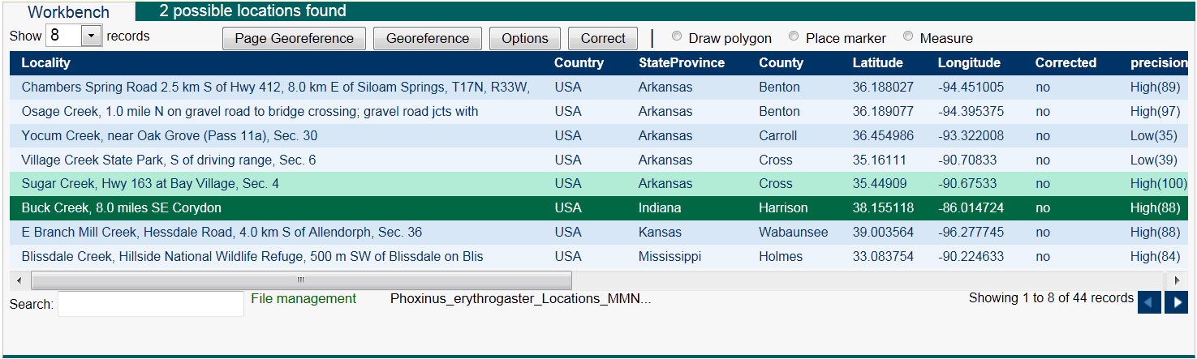
Batch Georeferencing

Slide 31
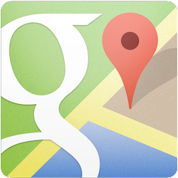
Google Maps
Search and directions
Free text search
Directions for traveling by car, bike, public transportation, or foot
Data compiled from different sources
Maps
Views: map, satellite, terrain, Google Street View
Sources of maps indicated at bottom

Slide 32
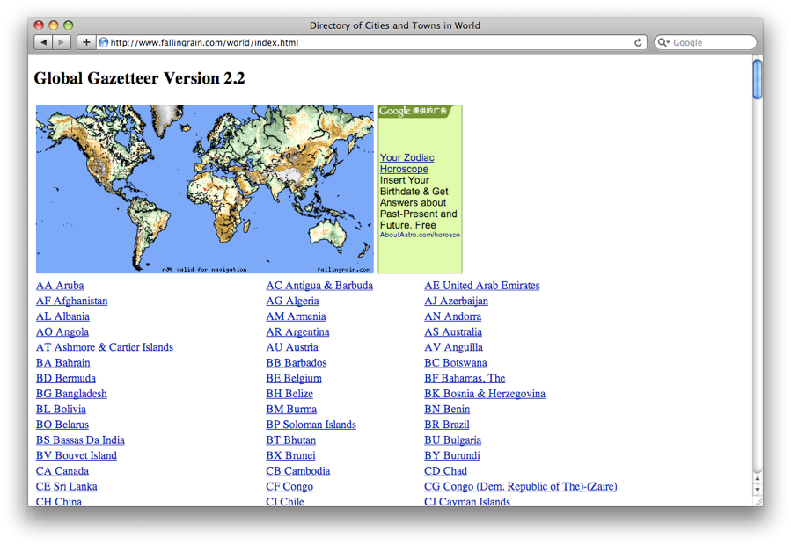
Falling Rain
Worldwide gazetteer for cities and towns
Great for hard to find localities, especially outside US
No search
Provides hierarchy, alternative names, too maps, altitude, weather information, and location of nearby towns
Example: Qaryeh-ye Gol’alam, Velayat-e Lowgar, AF
www.fallingrain.com

Slide 33
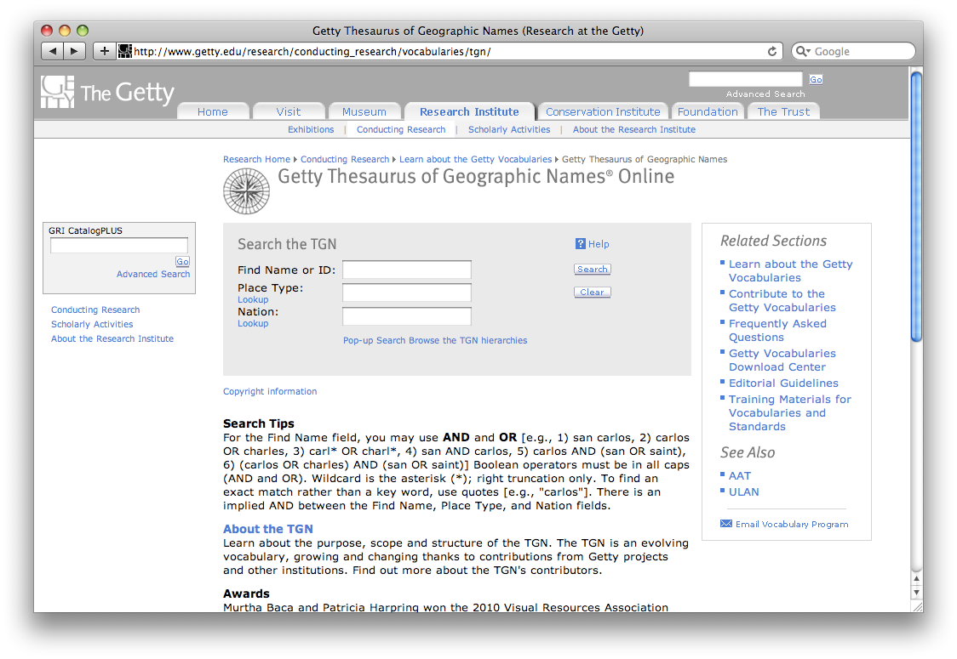
Getty Thesaurus of Geographic Names (TGN)
Worldwide gazetteer by The Getty
Useful for alternative and old names
Feature types
Geographical hierarchy
Degrees-minutes, not coordinates
Use recent name and search in Google Maps
Example: New Amsterdam, US
http://bit.ly/Getty-TGN

Slide 34
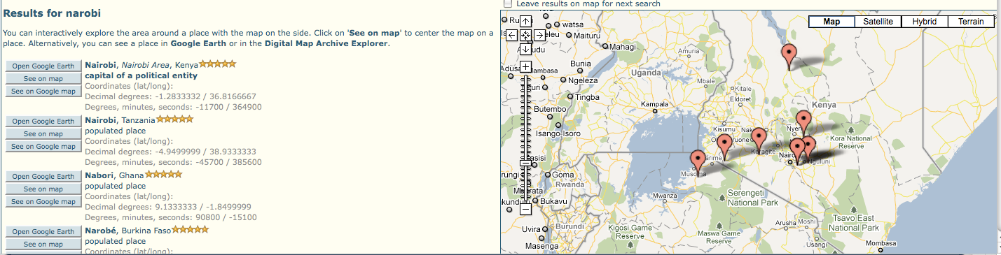
FuzzyG- JRC Fuzzy Gazetteer
Worldwide gazetteer designed for bad spelling
Useful for finding alternative, doubtful spelling, and old names
Feature types, by continent
Degree-minutes, not coordinates
Example: Narobi instead of Nairobi, Africa
http://dma.jrc.it/services/fuzzyg/

Slide 35

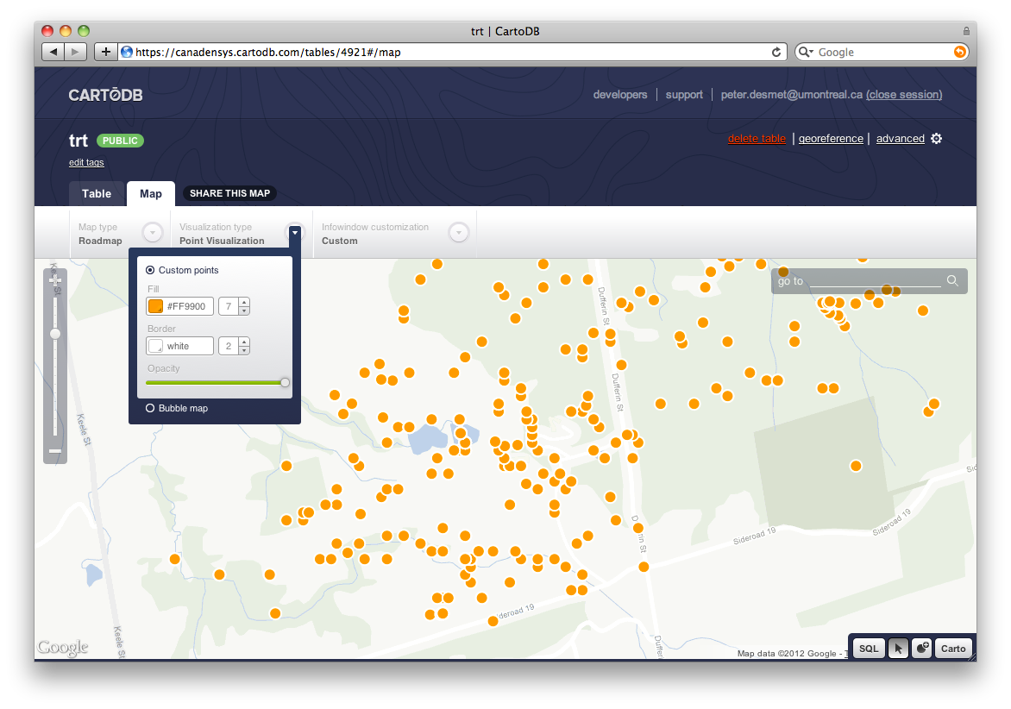
Other tools: Visualizing data
GPS Visualizer
Use to translate a file with coordinates into kml or a map
Carto
Online geospatial database
Drag and drop CSV upload
Easy customization of map
Share and embed map
Powerful development tools
http://www.gpsvisualizer.com/
http://carto.com

Slide 36
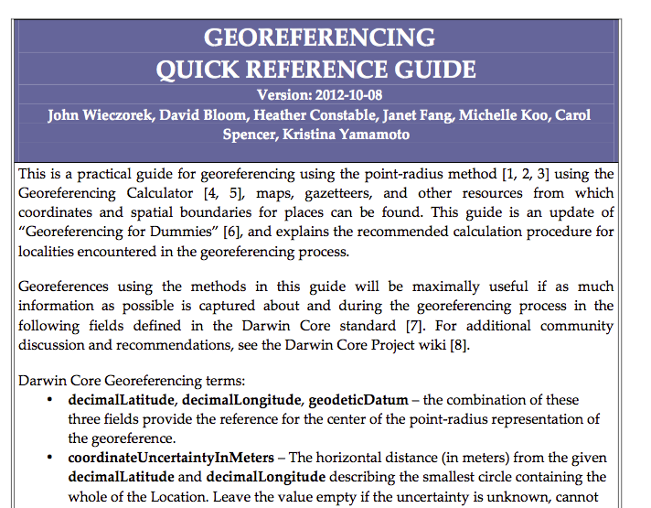
Georeferencing
Reference Guide
http://www.herpnet.org/herpnet/documents/GeoreferencingQuickGuide.pdf

Slide 37

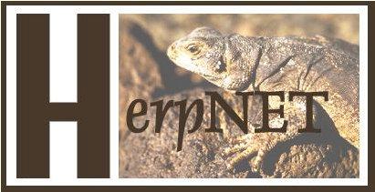
Links with links
https://www.idigbio.org/wiki/index.php/Georeferencing
http://herpnet.org/Gazetteer/GeorefResources.htm

